Slide 1


SRM Institute of science and technology
Quality of wine using regression
Presented by
Sujan-RA1911042010054
Balaji-RA1911042010010
Sarojini-RA1911042010058
Aravind-RA1911042010052
Computer science and engineering

Slide 2
Introduction
The dataset is related to the red variant of the Portuguese “Vinho Verde” wine.
These datasets can be viewed as regression tasks. The classes are ordered and not balanced (e.g. there are much more normal wines than excellent or poor ones). This can be applied in any such quality checking
Objectives
Apply Regression and find the quality of Wine
Objectives
This can be applied in any such quality checking
Quality of wine using regression

Slide 3
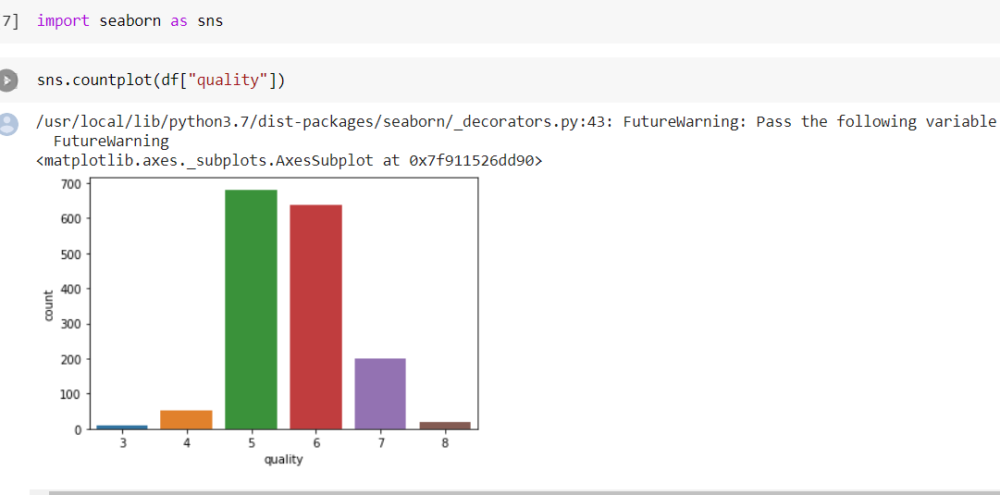
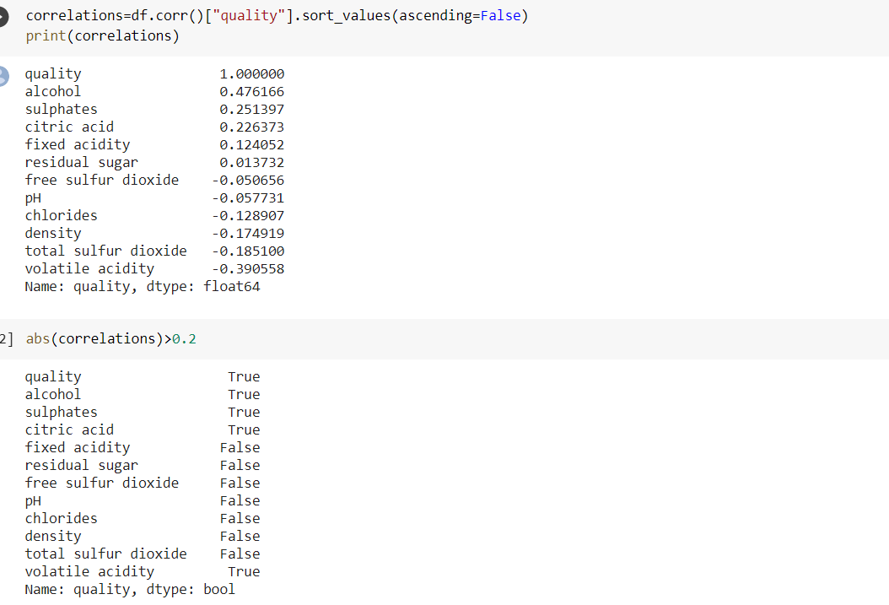
Theory and fundamentals
Why linear regression?
From the data provided, we can see that the values are in a continuous form and the input and output has linear relationship within it so i thought of going with linear regression approach of solving the problem
Data Exploration:
we plot important information ,help us check how features
behave ,how they are correlated. Knowing our target
variable is "quality", we now going to plot some
information about it
Data cleaning:
To study the correlation between quality and other features and see which are the ones that play an important role in deciding the quality of a wine we use a
function called corr() which gives the relationship between
the features and lables and also gives relationship
between the respective features Below is the screenshot
which shows the relationship between features and lables
After analysing the correlation data i selected the ones with
bigger numbers as correlation with the quality since these
are the ones that will give us more information and we
considered a minimum threshold of correlation
approximately around 0.2 (absolut value)
From all the values, we are selecting alcohol, sulphates, citric_acid and volatile_acidity
Quality of wine using regression

Slide 4
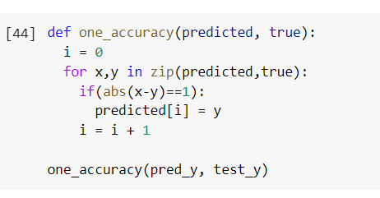
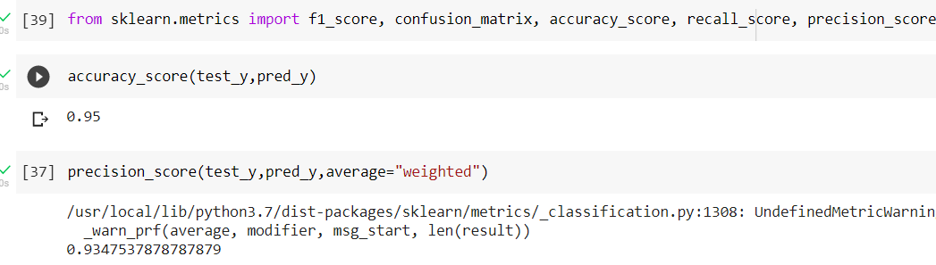
Methodology
Improving the results with 1-Off Accuracy:
As we can above our predictions aren't bad at all but in order to "improve" them we are going to apply a concept called 1-off accuracy, which states that if the distance between our predicted quality and the true quality is 1 (in absolut value), we will accept it as a correct prediction.
We will now create a function that will transform our
predicted value into the true value if the distance between
them is equal to 1. Afterwards we are going to plot the new
correlation matrices and test the new values with some
metrics. 1 off accuracy decreases the error and increase
the accuracy of our model RMSE after 1 off accuracy
is shown below Accuracy after 1 off accuracy is shown
below After using 1 off accuracy we are getting an
RMSE error of 75.4%
Accuracy of 95%
Quality of wine using regression

Slide 5
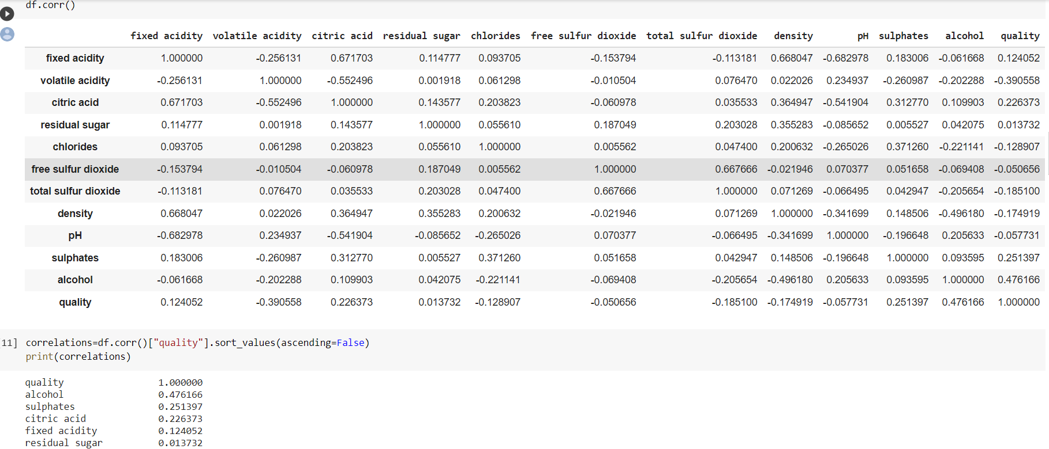
Tools and technologies
Tools:
Google colaboratory
Numpy • Pandas
Matplotlib
Seaborn
Sklearn
Math
Technologies:
Data Exploration:
Data cleaning:
RMSE of Models:
Approach used:
The task is to predict the quality of red wine with the provided dada. I have solved the problem using Linear Regression.
Quality of wine using regression

Slide 6
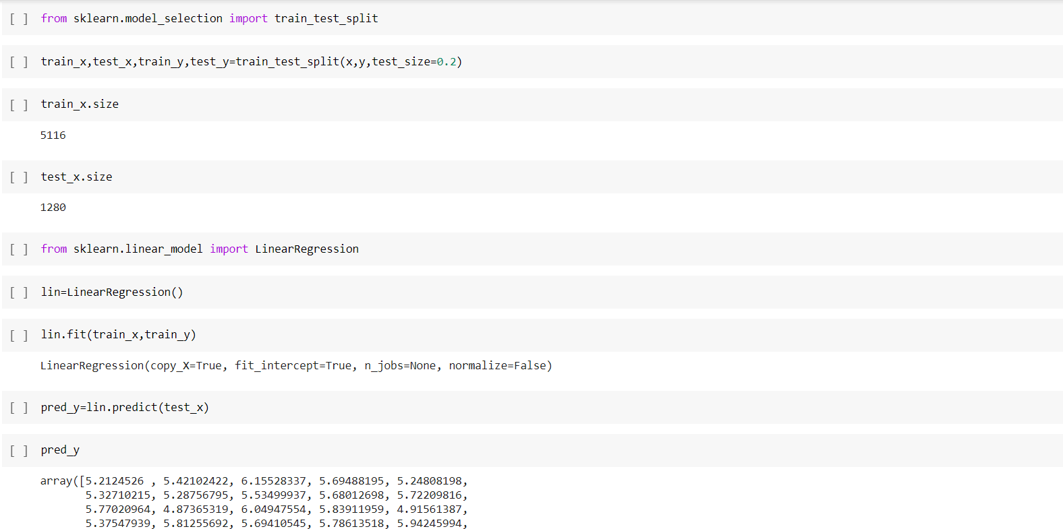
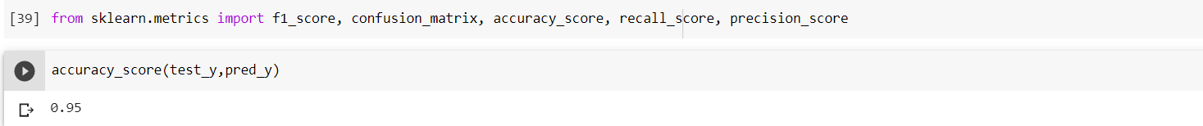
Testing / Experimentation
Train test split the data:
On this section, after having understood our data and dropped some useless features, we are going to make an estimation of quality based on the other features. To do so we are going to use Linear Regression
We separate our features from our target feature
(quality) and we split data into training and test
After splitting the data into train and test,
we import linear regression library and fit
our training data.
Now we predict the result (pred_y) with the
function predict by passing in the test x data
Now with accuracy score() function we can
find the accuracy of our model
Our model is now 95% accurate
Quality of wine using regression

Slide 7
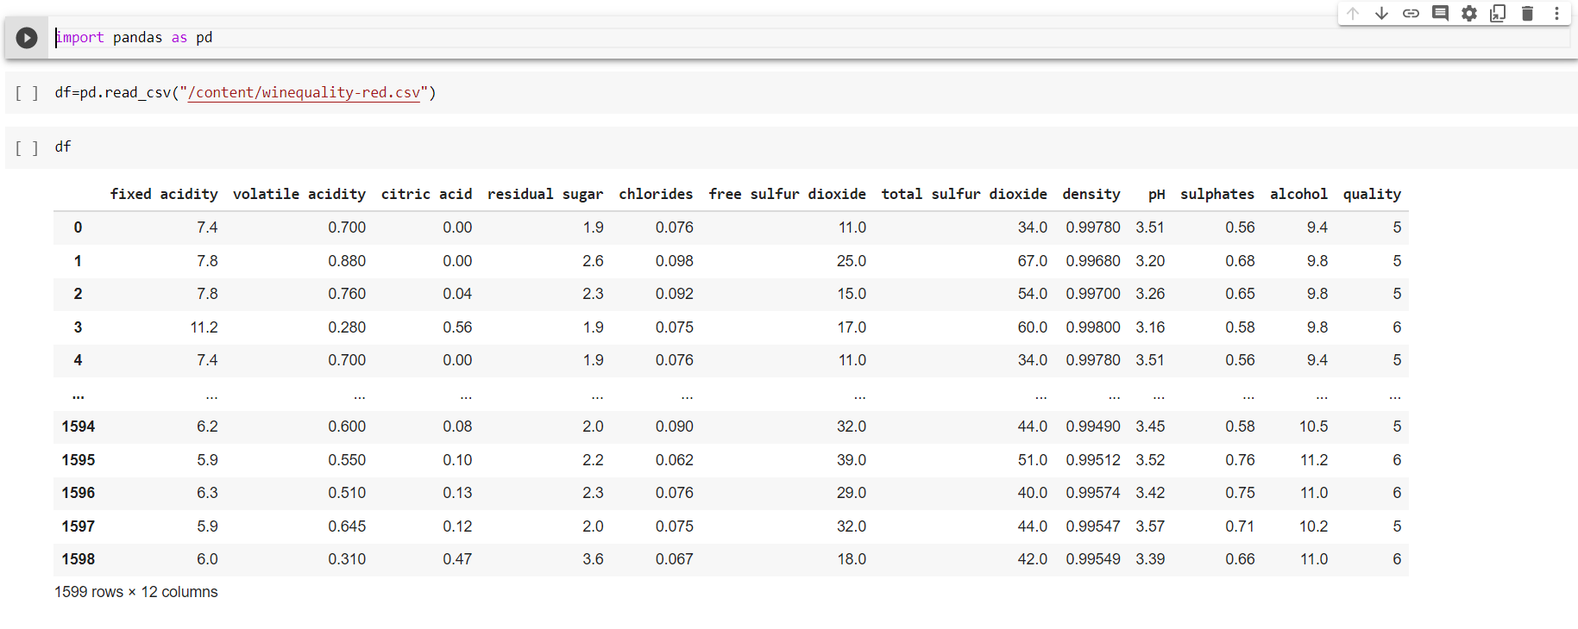
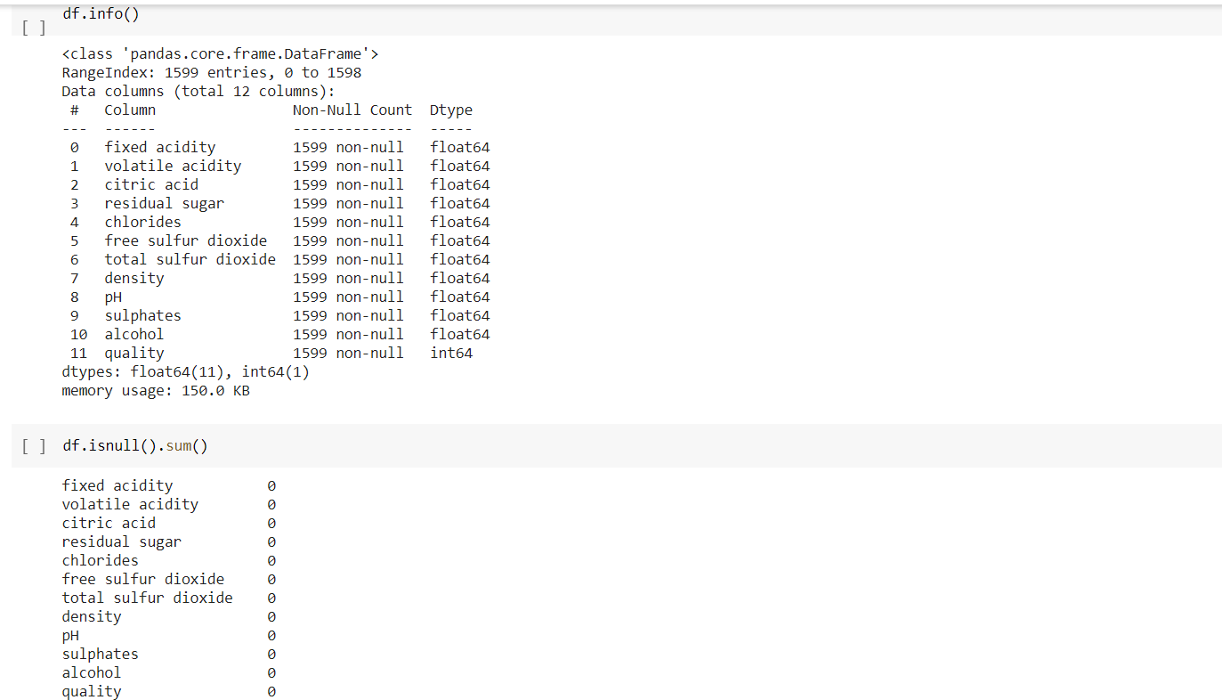
Data collection / Data analysis
Dataset information:
Input variables are fixed acidity,
volatile acidity, citric acid, residual
sugar, chlorides, free sulfur dioxide,
total sulfur dioxide, density, pH,
sulphates, alcohol. And the output
variable (based on sensory data) is
quality.
Analysing data:
With the pandas library we read the
provided csv data and store it in a
variable called df. We check the data
and count the missing values using
the functions info() and isnull () Below
is the screen shot of the data
Fortunately we find there are no null
values and all datatypes seem to be right.
Quality of wine using regression

Slide 8
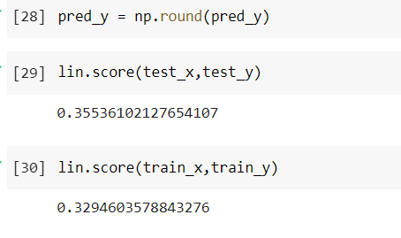
Findings and results
We found the quality of wine in the given data
We achieved a good accuracy of above 96 which give’s at most result of quality of
wine or for any other application quality check.
As we gone through the process of linear regression
we got less error by correlating and by implementing
improve 1-off and many with this tools.
Future scope
There is possibility of getting quality of every individual item their in the data
Quality of wine using regression

Slide 9
Conclusion
After having obtained all the results through our models and plots, these are some things we can say about this problem and solution:
The vast majority of wines get a quality rating of five or six, while having good and bad wines seems more unlikely. There seem not to be any excellent wines (>8) on this database.
From the very first moment we saw there weren't strong correlations between features and quality, that's why it's hard to make an accurate prediction using regression algorithms. That said, alcohol, sulphates, citric_acid features are the ones that correlate the most positively while volatile_acidity is the one correlating the most negatively.
Applying the concept 1-off Accuracy gives us much better results.
Linear Regression seems to be the best fitting models when solving this problem using regression.
Since there are only six different quality values in this dataset, it would be clever treating this problem as a multiclass classification and we might even get better results.
Quality of wine using regression

Slide 10


